Slide 1
WEB SCIENCE Distance Measurement
Group 1
Li Zhiqiang
Liu Xupeng
Rao Chencheng
Chen Haoran

Slide 2
Problem Definition
Measure the distance of two strings (Such as “Basketball” and “Football”) which represents two entities.
Automatically
Range ∈ [0, 1]
The distance can be compared

Slide 3
Motivation
Word Classification
Semantic Enhancement
Errors Recognition
As inputs of most NLP complex models

Slide 4
Problem Analyse
What is distance
1. without semantic——Edit distance
e.g. “cotton” and “botton”
2. semantic——Vector cosine distance, Jaccard distance
e.g. “LeBron James” and “Dwyane Wade”

Slide 5
Approaches
1. Algorithm
Edit distance algorithm
2. Models
Word2Vec
GloVe
3. Encyclopedia
Wikipedia
4. Tool
WordNet

Slide 6
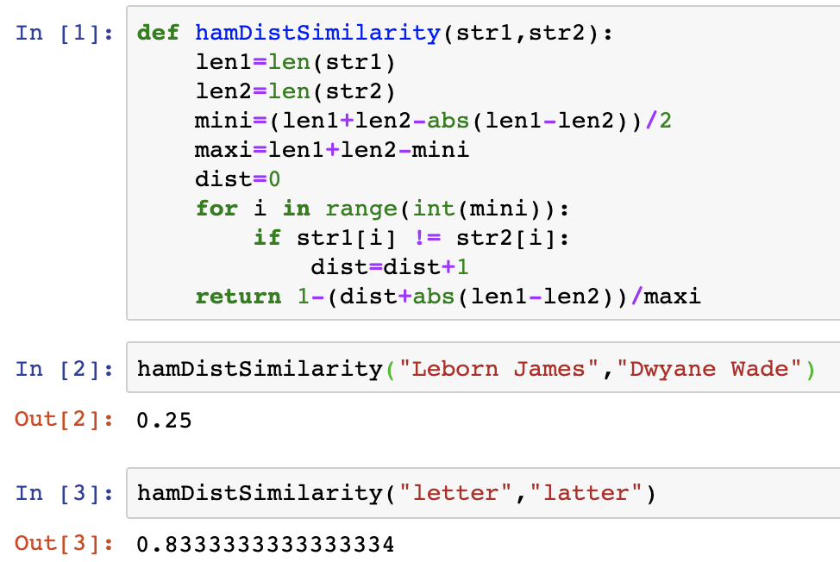

Hamming Distance
It is a simple method to calculate the difference in the position of the characters in the two strings.
$δ\left(s,t\right)=1−\frac{\left(\sum_{i=1}^{\min\left(\left|s\right|,\left|t\right|\right)}{s\left[i\right]≠t\left[i\right]}\right)+|\left|s\right|−\left|t\right||}{max⁡(\left|s\right|,|t|)}$

Slide 7
Algorithm——Levenshtein
Overview
Levenshtein is the minimum number of steps which are required for turning string A into string B by only three operations of additions, deletion, and replacement.

Slide 8
Algorithm——Levenshtein
Principles
Levenshtein gives a general method of editing distance, which is a classic dynamic programming problem .
The idea of dynamic programming is usually based on a recursive formula and one or more initial states, the solution of the current subproblem is derived from the solution of the last subproblem.

Slide 9
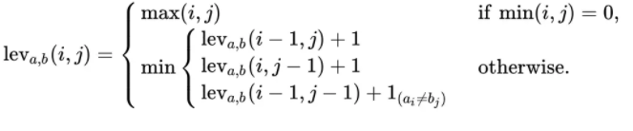
Algorithm——Levenshtein
yes→yet（1step） has→have (2step)

Slide 10
Algorithm——Levenshtein
The value of a of lev[i][j-1] means that at least a step converts x[1...i] into y[1...j-1], at which point we only need to be x[ 1...i] plus y[j] can be done to convert x[1...i] to y[1...j], so that x conversion to y requires a+1 step.
The value b of lev[i-1][j] means to convert x[1...i-1] to y[1...j] in at least b steps, then we only need to x[i] deletes the conversion of x[1...i] to y[1...j], so that x is converted to y and b+1 is required.
The value of the value k of lev[i-1][j-1] is to convert x[1...i-1] into y[1...j-1] in a minimum of k steps, which We need to judge whether x[i] and y[j] are equal. If they are equal, then we only need k steps to convert x[1...i] to y[1...j]; x[i] and y[j] are not equal, then we need to replace x[i] with y[j], so we need k+1 to convert x[1...i] to y[1. ..j].

Slide 11
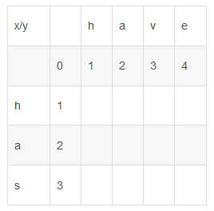
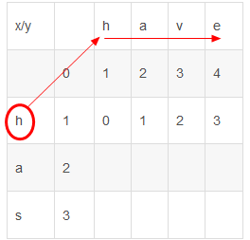
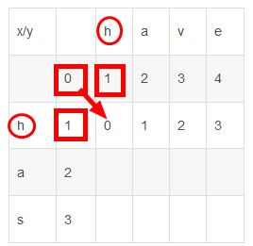
Algorithm——Procedure
Construct a matrix of (m+1)×(n+1), which is used to save the minimum number of steps required to complete a string conversion, and convert the string x[1..m] to the string y[1...n].The minimum number of steps required is the value of lev[m][n];

Slide 12
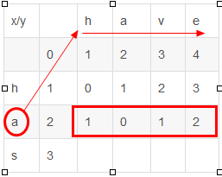
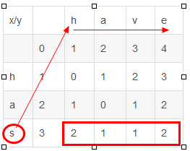
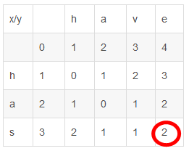
Algorithm——Diagram

Slide 13
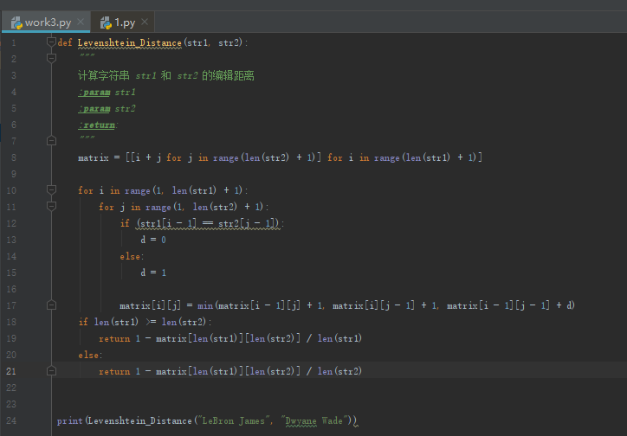
Algorithm——Code
After calculating the editing distance, we can get the Similarity = (Max(x,y) -levenshtein)/Max(x,y), where x and y are the length of source string and target string.

Slide 14
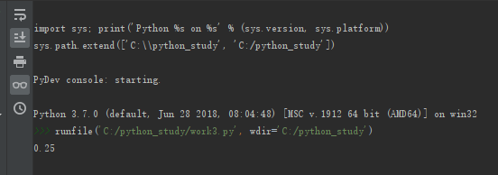
Algorithm——Result

Slide 15
Models——Word2Vec
Overview
Converting Words into Word Vectors
Training Center Words by Inputting Context Words
Semantics in Word Vectors

Slide 16
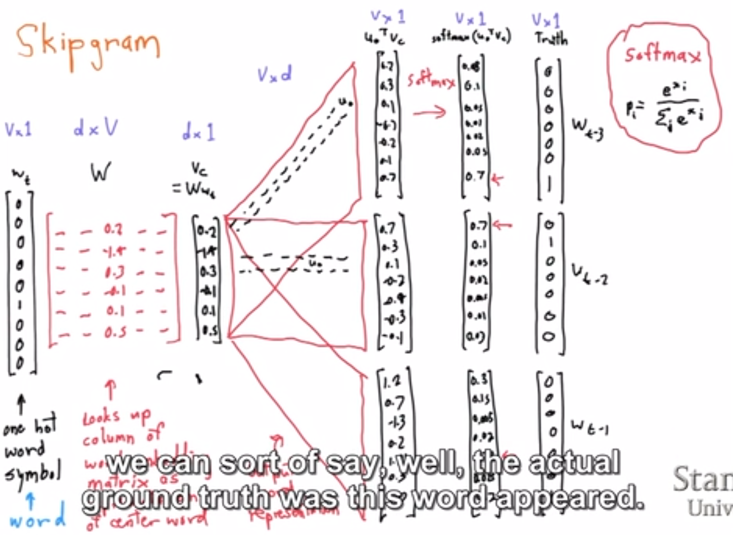
Models——Word2Vec
Principles
Skipgram model

Slide 17
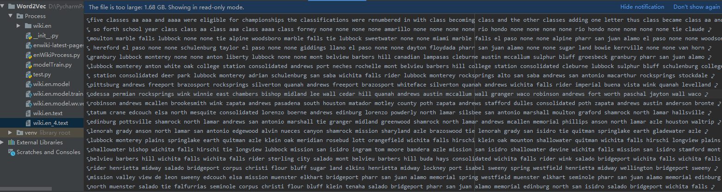
Models——Word2Vec
Experiments
Download Wikipedia corpus (15.4 G) and process it.

Slide 18
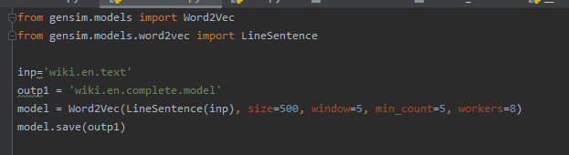
Models——Word2Vec
Experiments
Pip gensim and use it to train model

Slide 19
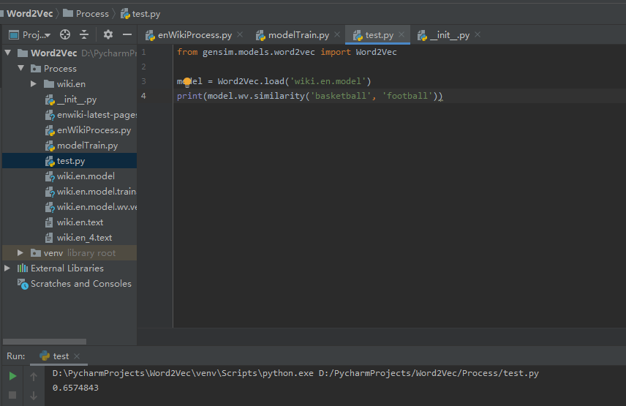
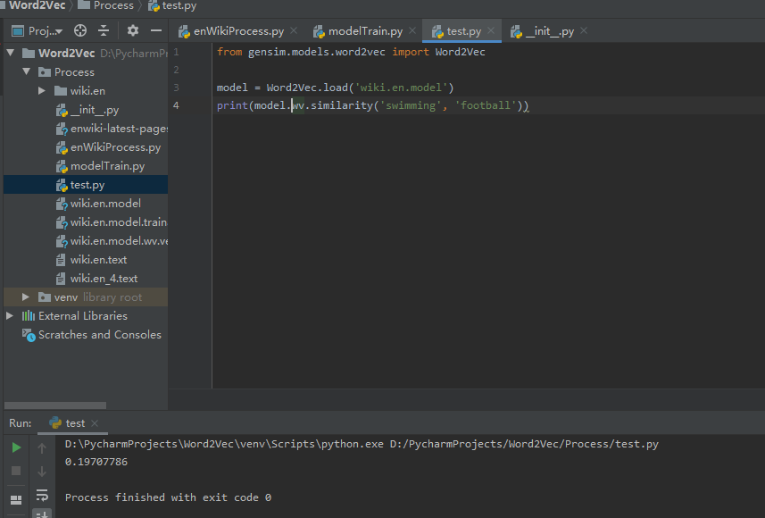
Models——Word2Vec
Experiments
Acquire model and analyse the selected sample

Slide 20
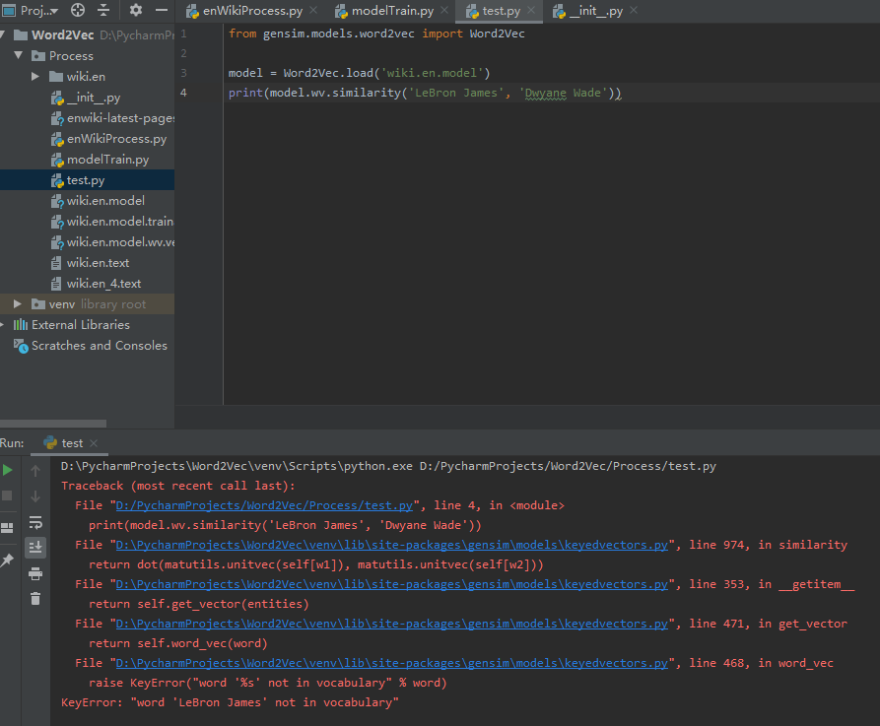
Models——Word2Vec
Evaluations
Semantic distance can be precisely calculated with large corpus trained.
Higher training efficiency.
Enhancing the Content of Words with less information in the Construction of Knowledge Graph.
Can't compare name entities.

Slide 21
Models——GloVe
Word2Vec VS GloVe
Both are Fundamentally Similar
Capture local co-occurrence statistics(neighbors)
Capture distance between embedding vector(analogies)
GloVe
Count-based Model (Word2Vec: Predictive Model)
Also captures global co-occurrence statistics
Requires upfront pass through entire dataset

Slide 22
Models——GloVe
Co-occurrence
Example: (window length=1)
• I like deep learning. • I like NLP. • I enjoy flying.

Slide 23
Models——GloVe
Predictive Model(Word2Vec)
Predict middle vocabulary according to the context (CBOW). Otherwise, the context is predicted according to the middle vocabulary (Skip-gram).

Slide 24
Models——GloVe
Count-based Model(GloVe)
Essentially, this model is to reduce dimension on the co-occurrence matrix.
Firstly, construct a co-occurrence matrix.
Reconstruction loss. Since that context is the combination of multiple vocabularies, the dimensions of matrix is quite large.

Slide 25
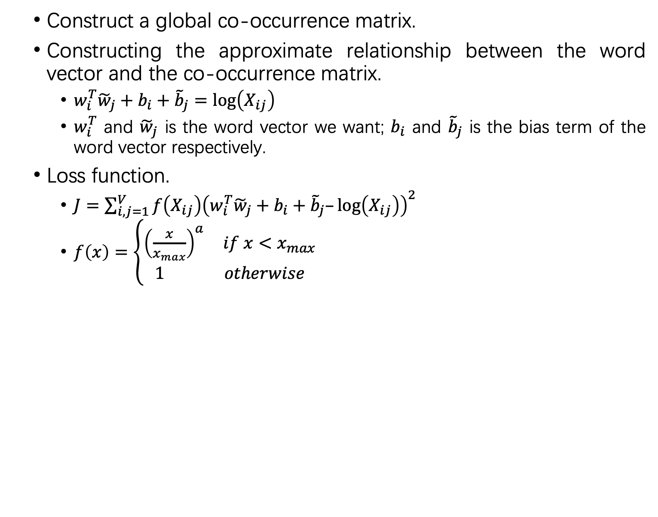
Models——GloVe
Steps
Construct a global co-occurrence matrix.
Constructing the approximate relationship between the word vector and the co-occurrence matrix.
$w_{i}^{T}{\tilde{w}}_{j}+b_{i}+{\tilde{b}}_{j}=\log\left(X_{ij}\right)$
$w_{i}^{T}$ and ${\tilde{w}}_{j}$ is the word vector we want; $b_{i}$ and ${\tilde{b}}_{j}$ is the bias term of the word vector respectively.
Loss function.
$J=\sum_{i,j=1}^{V}{f\left(X_{ij}\right){\left(w_{i}^{T}{\tilde{w}}_{j}+b_{i}+{\tilde{b}}_{j}–\log\left(X_{ij}\right)\right)}^{2}}$
$f\left(x\right)=\left\{\begin{aligned}{\left(\frac{x}{x_{max}}\right)}^{a} if x<x_{max} \\ 1 otherwise\end{aligned}\right.$

Slide 26
Models——GloVe
Performance
General performance is similar.
GloVe is easier to parallel.
For larger training data, GloVe is faster.

Slide 27
Models——GloVe
Experiment
Dataset： Amazon Food Comments [Kaggle]: Contains 568,454 food comments left by Amazon users before October 2012.
Framework：TensorFlow
Package: tf-glove

Slide 28
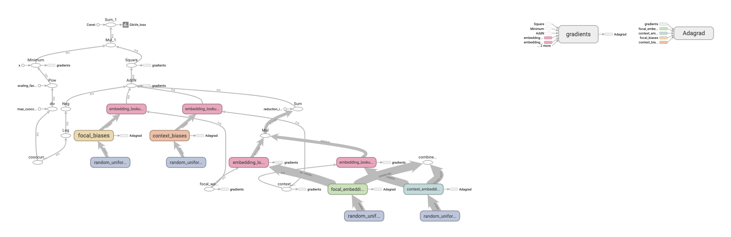
Models——GloVe
Experiment
Graph:

Slide 29
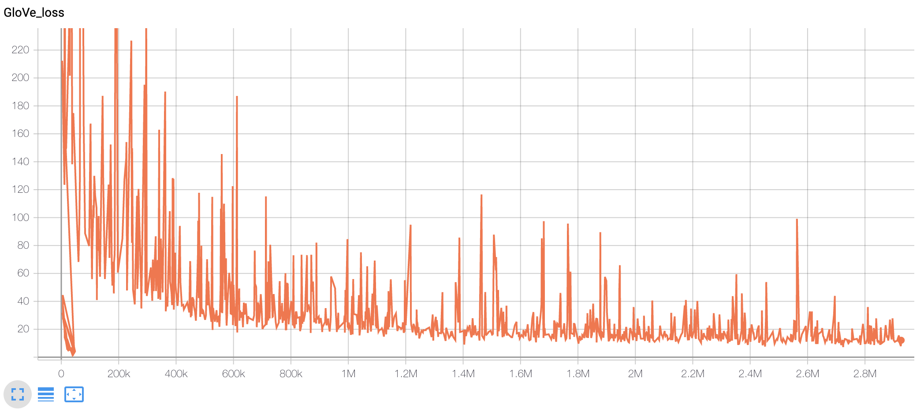
Models——GloVe
Experiment
Training:

Slide 30
Models——GloVe
Experiment Results(Cosine Similarity)
Examples:
“food” and “vegetable”: 0.22699127069561503
“meat” and “pepper”: 0.20619986854618572
“meat” and “beef”: 0.37730803898950477

Slide 31

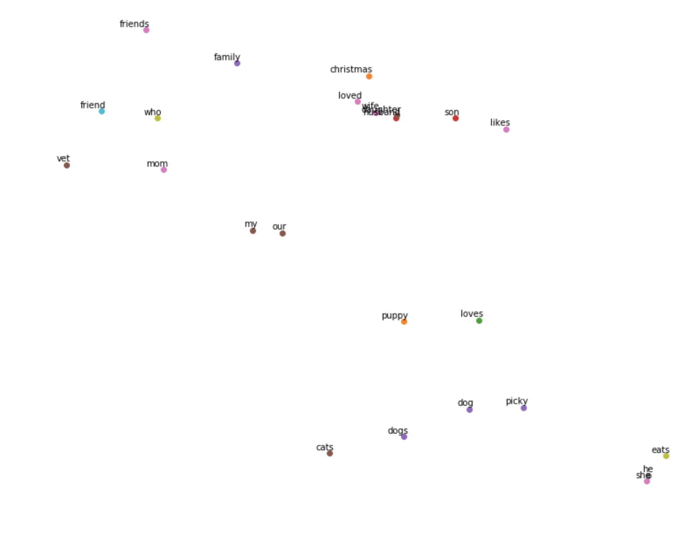
Models——GloVe
Experiment Results
2D visualization of the learned vector space
Top 1000 words
Zoom up

Slide 32
Wikipedia
Methods
Use Category system to compare the similarity of two entities.
Each instance has a page in wikipedia with many categories which represent some type relationship or other information
We compare the differences and commons of their categories to measure the distance

Slide 33

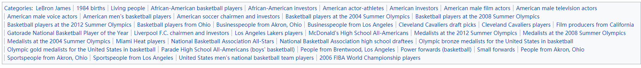
Wikipedia
Jaccard distance

Slide 34
Wikipedia
Evaluation
Semantic distance.
Easy to get and calculate.
Man-made categories, not precise enough.
Time limited, have not finish its code.

Slide 35
WordNet
A Lexical Database for English
Organise words with similar meaning into synset.
Hierarchical structure reveals subclass and superclass relationship
Structure can be used to measure semantic distance

Slide 36




WordNet
Experiments
Use nltk to download WordNet corpus.
Compare two entities.
D(football,soccer) > D(basketball,soccer)

Slide 37
Thank you!

